Slide 1

ENTERPRISE RESOURCE PLANNING
Introduction to ERP
Raghu B. A.
Department of Computer Science
and Engineering
raghubarao@pes.edu

Slide 2

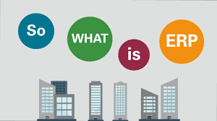
ENTERPRISE RESOURCE PLANNING (ERP)
Introduction to ERP
What is ERP (Enterprise Resource Planning)?
ERP is a complex software system that integrates business functions and their processes to manage them effectively and efficiently.
ERP attempts to integrate all departments and functions across a company onto a single computing system that can serve all those different departments’ particular information needs.
Every organization has several business processes within each department and across departments. ERP automates the tasks involved in performing these business processes.

Slide 3
ENTERPRISE RESOURCE PLANNING (ERP)
Introduction to ERP
What is ERP (Enterprise Resource Planning)?
Enterprise resource planning (ERP) is business process management software that allows an organization to use a system of integrated applications to manage the business and automate many back office functions related to technology, services and human resources.
Best ERP Software 2020 | Webopedia
www.webopedia.com
What is ERP in simple terms?
Enterprise resource planning (ERP) is defined as the ability to deliver an integrated suite of business applications. ERP tools share a common process and data model, covering broad and deep operational end-to-end processes, such as those found in finance, HR, distribution, manufacturing, service and the supply chain.
Definition of Enterprise Resource Planning (ERP) - Gartner
www.gartner.com

Slide 4
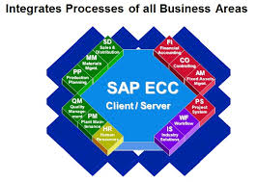
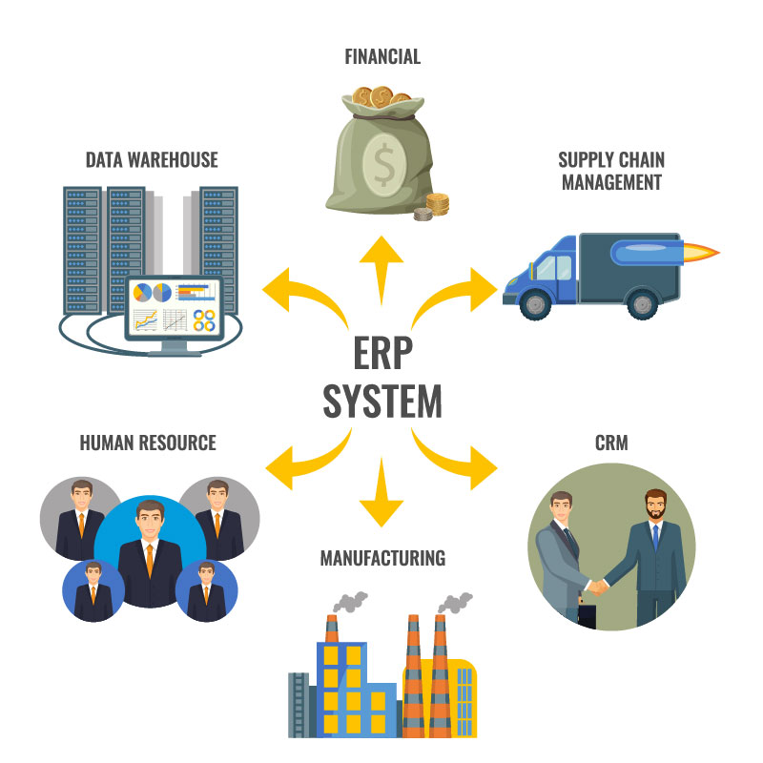
ENTERPRISE RESOURCE PLANNING (ERP)
Introduction to ERP
Seamless Integration of Business Processes in ERP

Slide 5
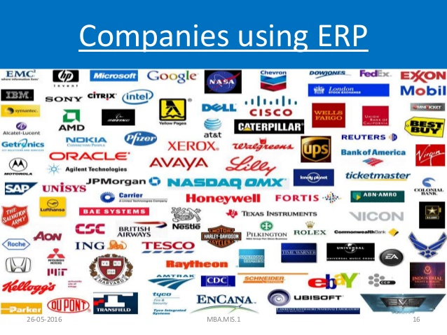
ENTERPRISE RESOURCE PLANNING (ERP)
Introduction to ERP
ERP Usage by Companies across Industries

Slide 6
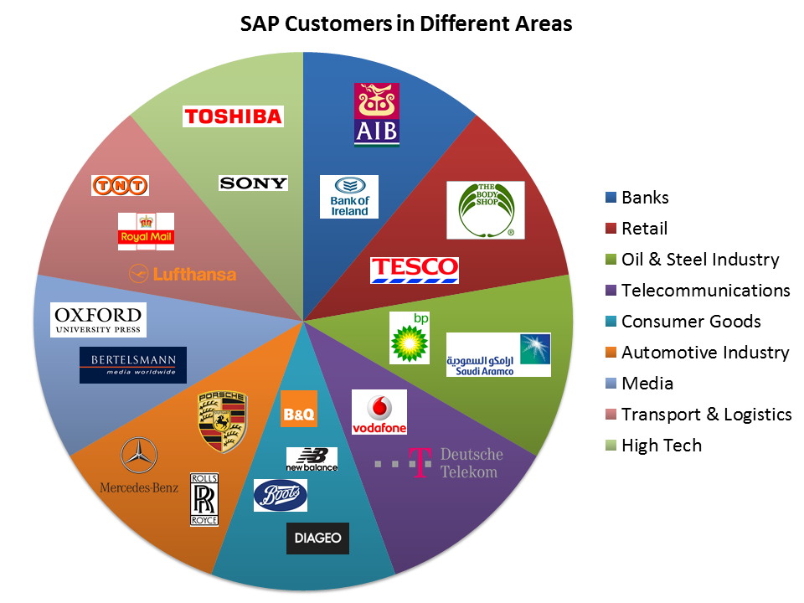
ENTERPRISE RESOURCE PLANNING (ERP)
Introduction to ERP
ERP Usage by Companies across Industries: Examples:
Manufacturing:
Automobile
Aerospace
Construction
Consumer goods
Pharma
Mining
Services:
Retail (FMCG)
Healthcare
Telecom & Other Utilities
Banking & Insurance (BFSI)
Transportation
Education

Slide 7
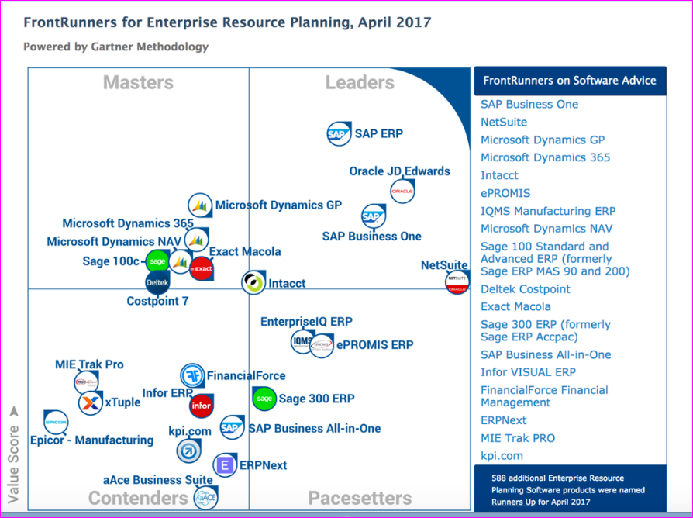
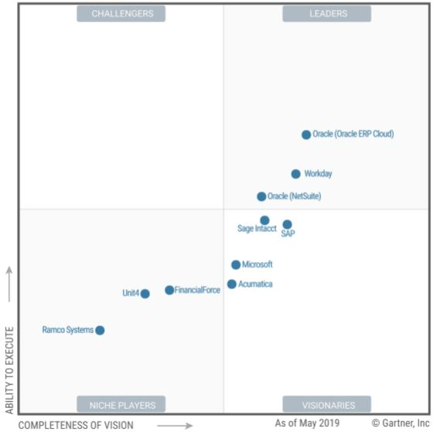
ENTERPRISE RESOURCE PLANNING (ERP)
Introduction to ERP
Comparison of ERP Product Companies by Gartner
2017 2019 ->

Slide 8
ENTERPRISE RESOURCE PLANNING (ERP)
Introduction to ERP
ERP Statistics – Market, Implementation, ROI, Cloud
ERP is a core system for businesses, driven by market characteristics such as widespread digital adoption, thriving global trade and vast amounts of data that need to be tracked, maintained and analyzed. ERP market statistics show the move towards increased usage and global demand.
The ERP market remains in a phase of rapid expansion, with total market size expected to exceed $49.5 billion by 2024.
The ERP market size in North America is worth over $10 billion.
The global ERP software market is expected to reach $78.4 billion by 2026.
In a survey of IT decision-makers, 53% said ERP was an investment priority.
ERP implementation led to business process improvement for 95% of businesses.
Forrester estimates that 2020 cloud subscriptions for business applications will account for $170 billion in revenue.
An international survey of ERP users indicated 64% of companies using SaaS, 21% using cloud ERP and only 15% using on-premises.
In a survey on ERP implementation, midsize companies with $100 million to $250 million in revenue had the fastest implementations at 6.6 months. Very large companies, over $25 billion in revenue, took the longest at 12.35 months.
In a 2019 survey of distributors and manufacturers, 67% described their implementations as successful or very successful.

Slide 9
ENTERPRISE RESOURCE PLANNING (ERP)
Introduction to ERP
Trends and Future of ERP
As business needs become more complex, ERP software is advancing to meet the demand for more customizable features and broader social integrations.
Current ERP trends illustrate a shift towards greater cloud adoption and intelligent systems that streamline and automate processes.
• By 2022, Gartner predicts that artificial intelligence (AI) will be integrated into ERP systems by 65% of CIOs.
• 53% of UK CIO’s are looking for more intelligent ERP systems that include technology like machine learning, AI and automation.
• CIO’s listed predictive analytics and deep learning as the most critical ERP technologies to gain a competitive advantage.
• Fifteen percent of organizations plan to increase their Internet of Things (IoT) budget.

Slide 10
ENTERPRISE RESOURCE PLANNING (ERP)
Introduction of ERP Systems
Course Prerequisites
Understanding of software technologies
Awareness of Software Development Life Cycle (SDLC)
Awareness of current day Information Technologies
Inclination towards understanding business & managerial processes

Slide 11
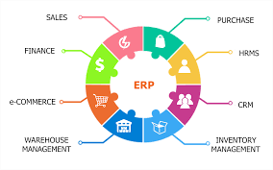
ENTERPRISE RESOURCE PLANNING (ERP)
Introduction to ERP
ERP Course Overview
This course discusses the processes of an organization and how ERP supports those processes. It also covers other emerging applications beyond ERP like Supply Chain Management, Customer Relationship Management, Product Life cycle Management and Others.
Highlights:
Extensive coverage of ERP Life Cycle including Change management, Business Process Re-engineering (BPR) and Modeling (BPM).
Focuses on ERP modules like Production Planning, Procurement and Inventory Management, Finance and HR Management.
Discussions on Benefits and Costs of ERP Implementation.
Criteria for selection of ERP Implementation partner and ERP package.
Other related systems that will be covered in brief are CRM, SCM, PLM, DW-BI-Analytics, etc. that work with ERP system.
Discussions on ERP for different industries and emerging trends.

Slide 12
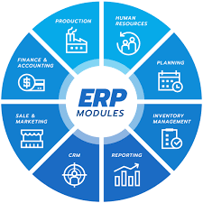
ENTERPRISE RESOURCE PLANNING (ERP)
Introduction to ERP
ERP Course Overview
Overview of ERP
Implementation Life cycle
Change Management
Bus. Process Re-engineering
Project Team and Management
Package & Partner Selection
Success & Failure Reasons
Implementations in Industries
Articles and Case Studies
ERP Modules:
Finance
HCM (or HR)
Procurement
Inventory
Production
Extended ERP:
CRM
SCM
PLM
DW-BI & Analytics
Cloud ERP

Slide 13
ENTERPRISE RESOURCE PLANNING (ERP)
Introduction to ERP
Course Objectives:
The objective(s) of this course are :
1. To learn the strategic importance of Enterprise Resource Planning systems in industry
2. To learn the basics of ERP, costs, benefits and the modules of ERP
3. To learn about Change Management, Business Process Re-engineering and Modeling
4. To learn key selections criteria, issues & risks involved in ERP implementation
5. To be aware of ERP Risks, CSFs, related technologies and commercial ERP software.
Course Outcomes:
At the end of the course, the student will be able to:
1. Identify typical functionality of ERP sub-systems
2. Identify strategies for Change Management, BPR and BPM
3. Apply criteria to select ERP Package and Consulting Partner
4. Systematically develop plans for an ERP Implementation project and
5. Identify critical success factors and associated risks.

Slide 14
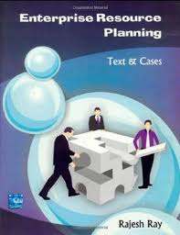

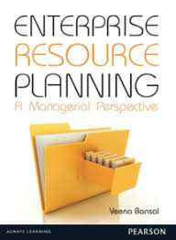



ENTERPRISE RESOURCE PLANNING (ERP)
Introduction to ERP
Text Book, Reference Books

Slide 15
ENTERPRISE RESOURCE PLANNING (ERP)
Introduction of ERP Systems
Course Evaluation Policy
Activity | Marks | Reduced Marks | Remarks
Test-1 [Units 1-3] | 60 | 20 | As per the TT announced by the COE
Test-2 [Units 4-5] | 40 | 15 | As per the TT announced by the COE
Assignments | 15 | 15 | 1-4 Individual Assignments, 1 Group Mini Project. (no programming/coding)
Total ISA |  | 50
Total ESA | 100 | 50 | As per the TT announced by the COE
TOTAL ISA + ESA |  | 100

Slide 16
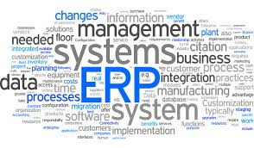
THANK YOU
Introduction to ERP
Raghu B. A.
Department of Computer Science
and Engineering
raghubarao@pes.edu

